Slide 1


An internship report on
EMPLOYABILITY SKILLS
submitted in partial fulfillment of the requirements for the award of the degree of
BACHELOR OF TECHNOLOGY IN
COMPUTER SCIENCE AND ENGINEERING
BY
ARDHANI MOULI VENKAT
236K5A0502
DEPARTMENT OF COMPUTER SCIENCE AND ENGINEERING
IDEAL INSTITUTE OF TECHNOLOGY
APPROVED BY AICTE, AFFILIATED TO JNTUK, KAKINADA
VIDYUT NAGAR, KAKINADA-533003, E.G.D.T, ANDHRA PRADESH

Slide 2
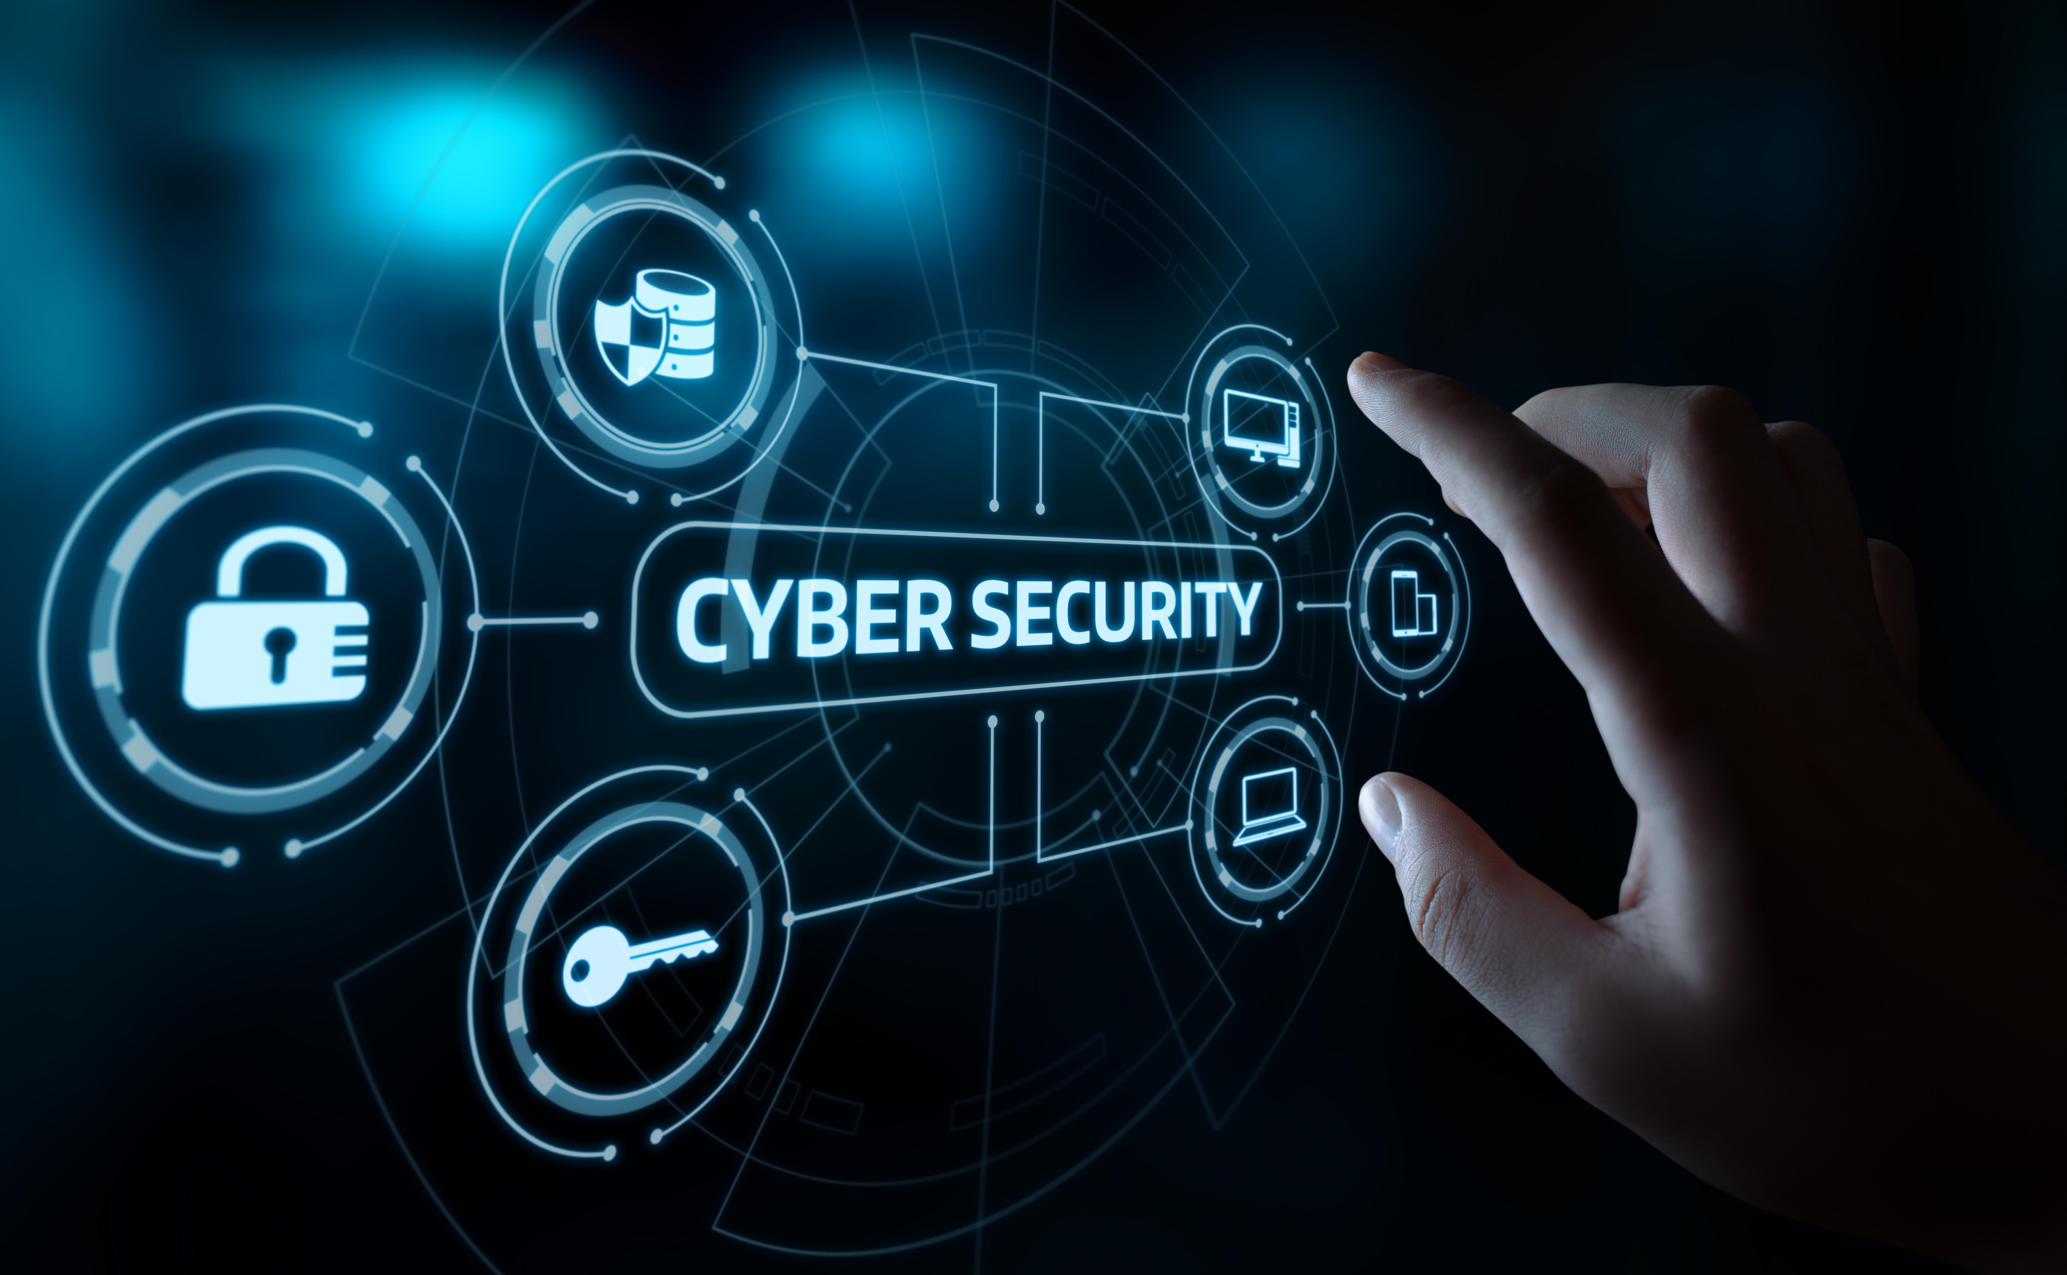
What is Cyber Security?
Cybersecurity refers to the practice of protecting systems, networks, and data from digital attacks, unauthorized access, damage, or theft. It involves a combination of technologies, processes, and best practices to safeguard information and ensure the integrity, confidentiality, and availability of digital assets
Key Goals:
Protect sensitive data
Maintain trust in systems

Slide 3
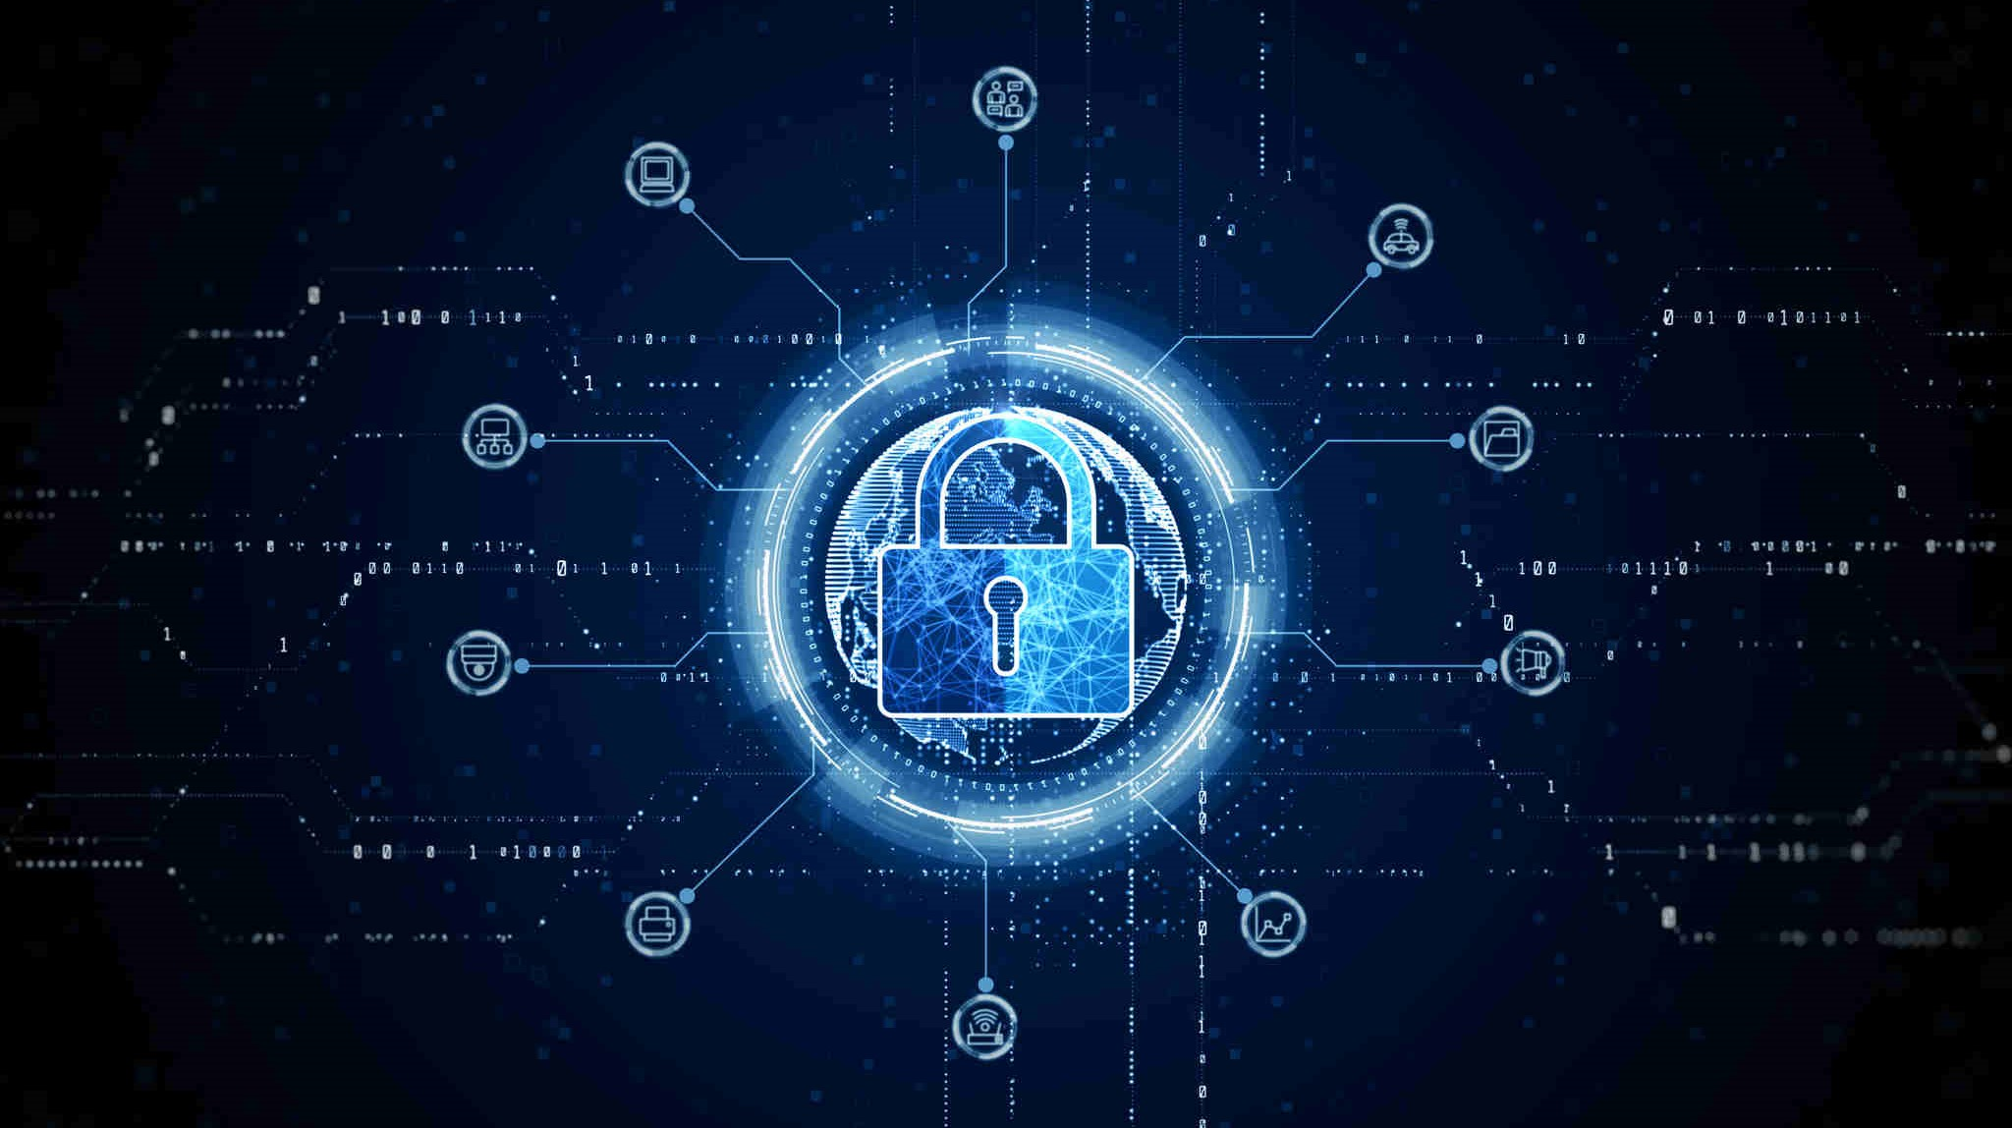
Why is Cyber Security Important?
Cybersecurity is essential in today’s digital age for several critical reasons Such as :
Protects Sensitive Data
Prevents Financial Loss
Ensures Business Continuity
Protects Against Evolving Threats
Supports National Security
Safeguards Emerging Technologies

Slide 4
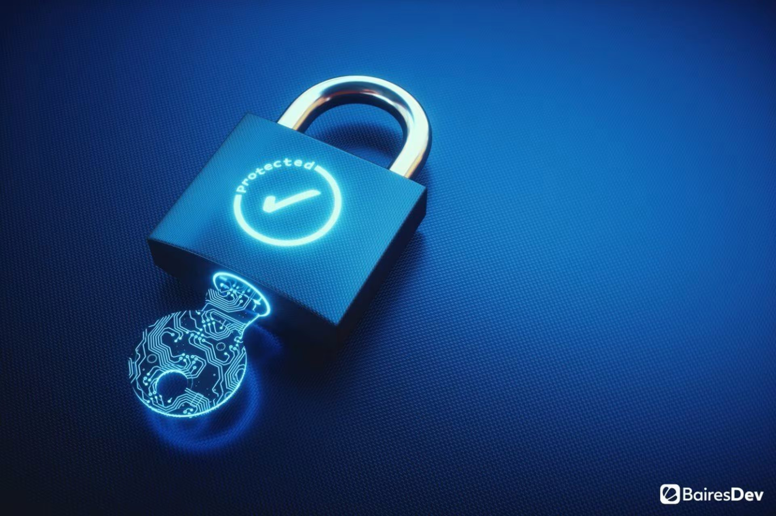
Key Components of Cyber Security
Network Security: Protects networks from attacks using firewalls, intrusion detection, and encryption
Application Security: Ensures software is free of vulnerabilities through secure coding practices
Information Security: Focuses on protecting data confidentiality, integrity, and availability
Operational Security: Defines processes to secure sensitive information during operations

Slide 5
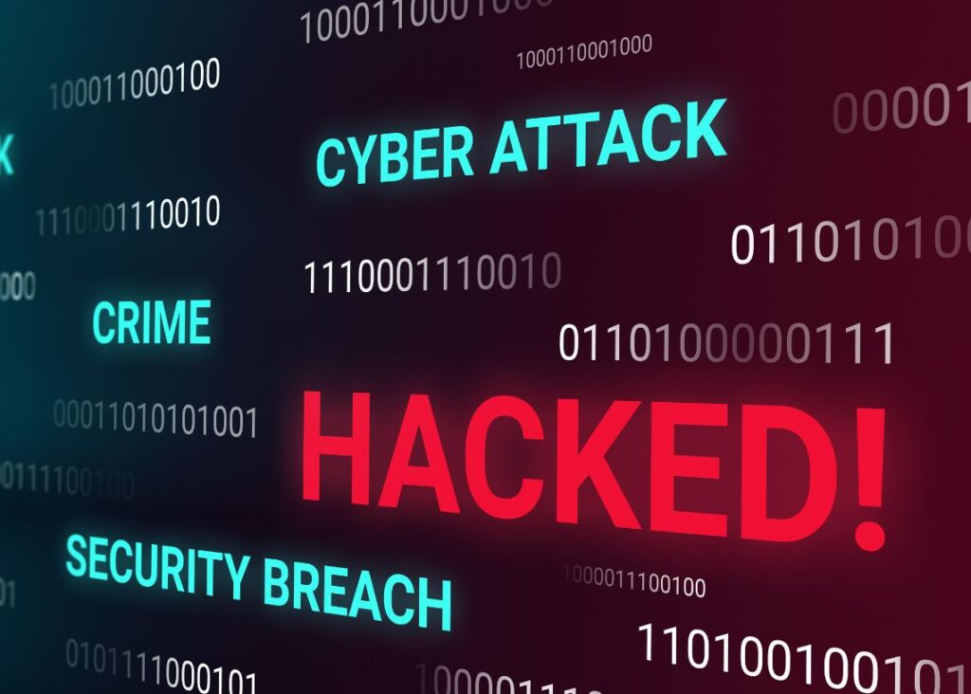
Common Cyber Threats
Malware: Malicious software that damages or disrupts systems
Phishing: Deceptive methods to steal sensitive information through fake emails or websites.
Man-in-the-Middle Attacks: Cybercriminals intercept and alter communications
Denial of Service (DoS): Overloading systems to make them unavailable
Insider Threats: Risks posed by employees or trusted individuals

Slide 6
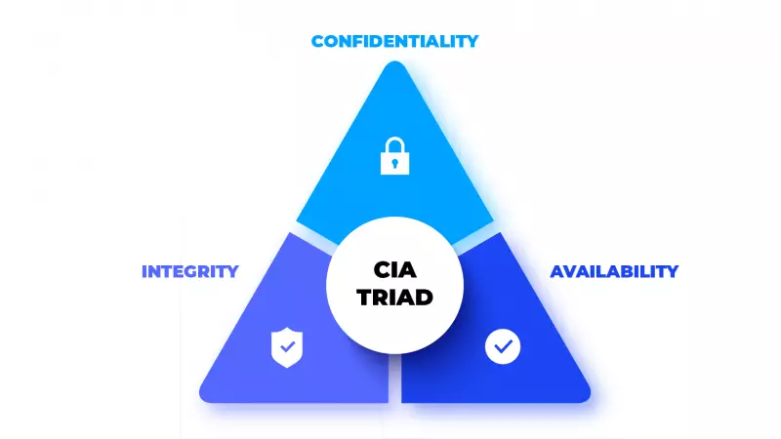
The CIA Triad
Confidentiality: Preventing unauthorized access to sensitive information
Integrity: Ensuring data is accurate and has not been tampered with
Availability: Keeping systems and data accessible to authorized users

Slide 7
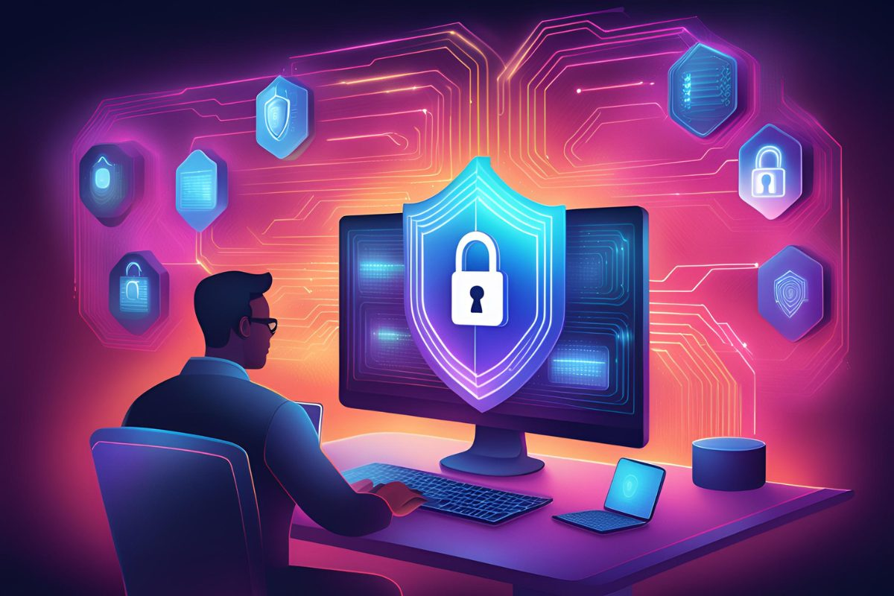
Cyber Security Best Practices
Enable Two-Factor Authentication (2FA): Adds an extra layer of security
Regular Updates: Patch vulnerabilities by keeping software and systems current
Strong Passwords: Use a combination of letters, numbers, and symbols
Educate Users: Train employees to recognize phishing and other social engineering tactics
Backup Data: Regular backups minimize data loss risks

Slide 8
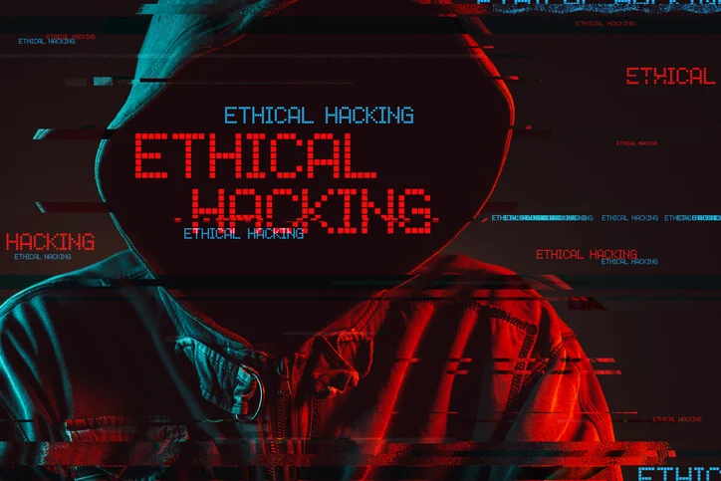
The Role of Ethical Hacking
Ethical hacking plays a crucial role in cybersecurity by proactively identifying vulnerabilities and weaknesses in systems, networks, and applications. Ethical hackers, also known as white-hat hackers, use the same techniques as malicious hackers but do so with permission and the intent to improve security. Their work is critical in safeguarding sensitive data and ensuring robust defenses against cyber threats

Slide 9

Cyber Security and Emerging Technologies
AI in Cyber Security:
Detects patterns in data for potential threats.
IoT Security:
Securing billions of interconnected devices from being exploited
Blockchain:
Improves trust and transparency in transactions

Slide 10

Future Trends in Cyber Security
Zero Trust Architecture: No implicit trust; always verify.
Quantum-Resistant Encryption: Prepares for quantum computing risks.
Cyber Security-as-a-Service: Outsourcing security to specialized firms.
Privacy Regulations: E.g., GDPR and CCPA enforcement

Slide 11

Conclusion
Cyber security is an essential pillar in safeguarding our digital lives, protecting personal data, organizational assets, and national infrastructure from ever-evolving threats. By adopting proactive measures, embracing best practices, and staying informed about emerging technologies, we can build a safer digital environment. Remember, cyber security is not just a technical responsibility but a shared commitment to vigilance and resilience in the face of growing cyber risks

Slide 12
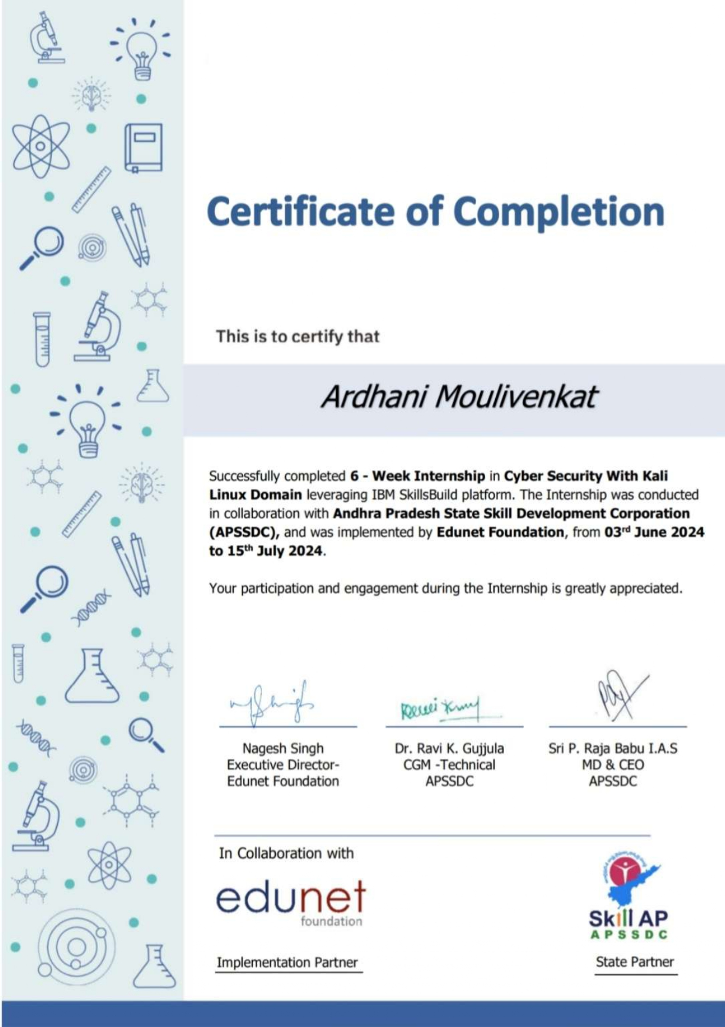

Slide 13

THANK YOU

